Slide 1

BIR DV Dataswap
May 2025

Slide 2
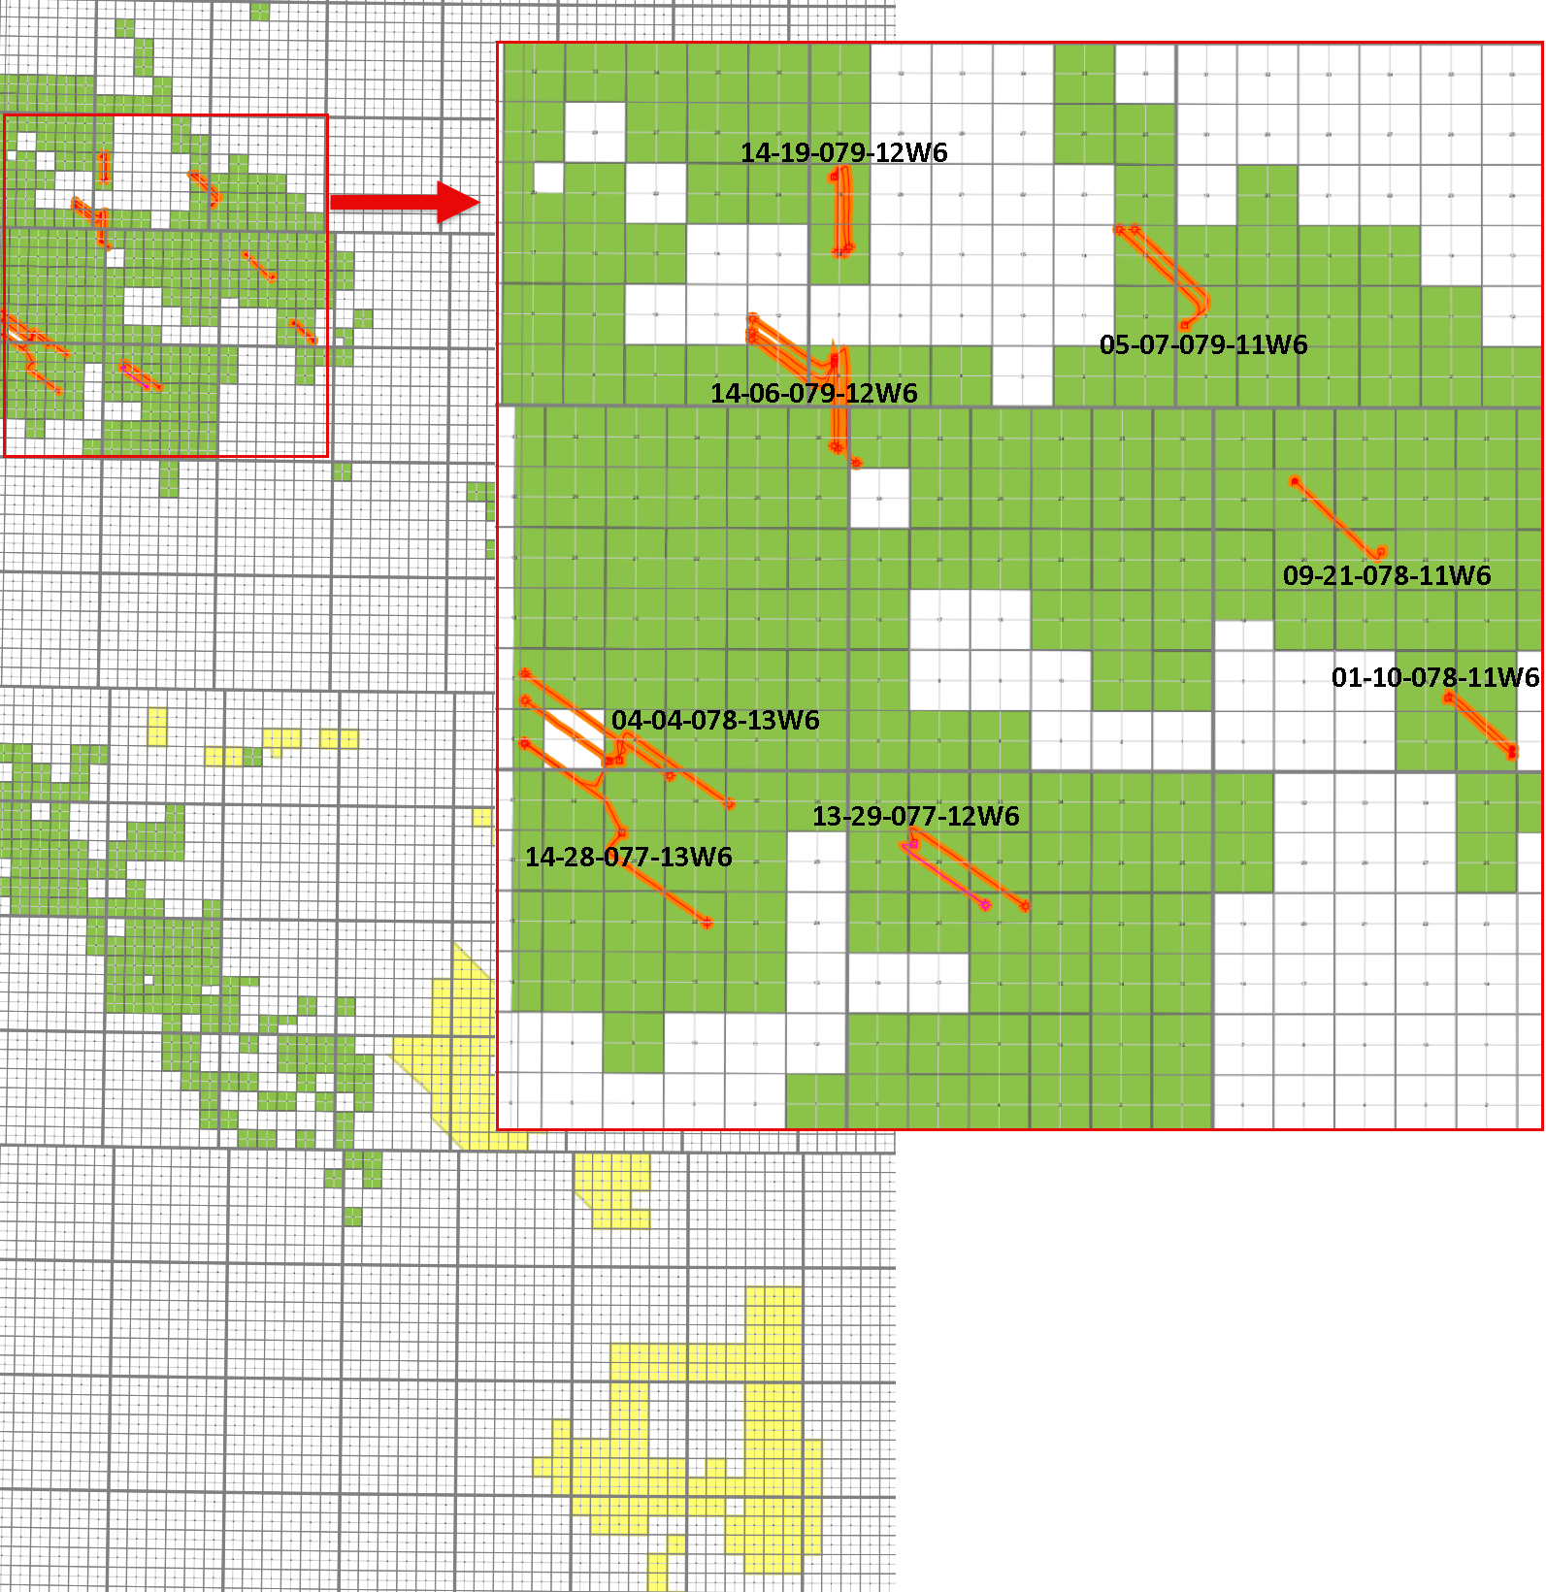
Summary
PAD_LOCATION | BIR_UWI | BIR_ZONE_SHORT | VINTAGE | STAGES ANALYSED | BIR TRIAL/COMMENTS | Stabilized CGR | Average Intensity (T/m) | Average Stage Length (m)
14-19-079-12W6 | 105/10-18-079-12W6/0 | C | 2020 | 18 | Cluster count (4, 5, 6 and 8) | 20-35 | 1.5 | 100
14-19-079-12W6 | 106/10-18-079-12W6/0 | D2 | 2020 | 20 | Cluster count (3,4,5) and oriented versus not | 20-35 | 1 | 100
14-06-079-12W6 | 100/04-12-079-13W6/0 | C | 2023 | 8 | 5 versus 8 cluster only heel half of the well analysed | 20-35 | 1 | 42
14-19-079-12W6 | 104/10-18-079-12W6/0 | D1 | 2020 | 15 | cluster count (5, 6, 8) | 20-35 | 1 | 115
14-28-077-13W6 | 100/07-22-077-13W6/0 | E3+ | 2021 | 17 | upper montney cluster uniformity | 10-15 | 2 | 110
04-04-078-13W6 | 102/02-07-078-13W6/0 | E3+ | 2021 | 28 | high tonnage 3 TPM on entire well,6vs 8 clusters | 10-15 | 3 | 80
14-06-079-12W6 | 102/05-12-079-13W6/0 | D1 | 2023 | 20 | alternating 5 and 10 cluster design | 15-20 | 1 | 100
05-07-079-11W6 | 102/14-13-079-12W6/0 | D1 | 2021 | 23 | Parent vs non parent | 15-20 | 1.5 | 125
04-04-078-13W6 | 100/10-07-078-13W6/0 | E3+ | 2021 | 27 | 4 vs 6 cluster design | 10-15 | 1 | 100
04-04-078-13W6 | 102/13-34-077-13W6/0 | D1 | 2022 | 17 | depletion response on cluster efficiency | <10 | 1 | 85
14-06-079-12W6 | 102/08-36-078-13W6/0 | D1 | 2021 | 16 | effect of tonnage and stage length | 15-20 | 1.5 | 125
13-29-077-12W6 | 103/14-21-077-12W6/0 | D1 | 2022 | 17 | Parent vs non parent | <10 | 1.5 | 135
04-04-078-13W6 | 100/07-06-078-13W6/0 | E3+ | 2021 | 13 | effect of depletion | 15-20 | 1 | 100
13-29-077-12W6 | 100/16-21-077-12W6/0 | D1 | 2022 | 24 | Parent vs non parent and perf orientation | 10-15 | 1 | 130
01-10-078-11W6 | 103/08-02-078-11W6/0 | D1 | 2019 | 19 |  | 35-50 | 1.5 | 105
01-10-078-11W6 | 102/08-02-078-11W6/0 | D2 | 2019 | 20 |  | 35-50 | 1.5 | 65
14-06-079-12W6 | 102/04-12-079-13W6/0 | D1 | 2023 | 7 | far to near field geometry | 15-20 | 1 | 145
05-07-079-11W6 | 100/13-13-079-12W6/0 | D1 | 2021 | 25 | DFIT-FBA and cluster relationship, parent vs non parent | 15-20 | 1.5 | 125
14-06-079-12W6 | 100/04-31-078-12W6/0 | D1 | 2021 | 20 | effect of tonnage and stage length | 15-20 | 1.5 | 120
14-06-079-12W6 | 100/08-36-078-13W6/0 | C | 2021 | 16 | effect of tonnage and stage length | 20-35 | 1.7 | 125
14-28-077-13W6 | 102/07-06-078-13W6/0 | D1 | 2021 | 5 | depletion response on cluster efficiency | <10 | 1 | 130
04-04-078-13W6 | 100/05-35-077-13W6/0 | C | 2022 | 37 | cluster design (number and spacing) | <10 | 1 | 85
09-21-078-11W6 | 106/14-29-078-11W6/0 | D2 | 2019 | 27 | cluster design (number and spacing) | 200 | N/a | N/a
14-19-079-12W6 | 100/11-18-079-12W6/0 | D1 | 2020 | 20 | far to near field geometry | 20-35 | 1 | 100

Slide 3
Recommendation - Data Tiering
Tier | UWI | Reason | Reservoir/Design
1 | 100/04-12-079-13W6/0 (MNTN C) | Tight Stage Spacing (40m average) | 1T/m & 30bbl/mmcf & 25-100m/stage
 | 102/05-12-079-13W6/0 (MNTN D1) | 5 vs 10 Cluster Test (Cluster Spacing Test) | 1T/m & 12bbl/mmcf & 100m/stage
 | 100/08-36-078-13W6/0 (MNTN C) | Intensity & Stage Length Test (1-3T/m & 110/140m) | 1.7T/m & 17bbl/mmcf & 110-140m/stage
2 | 105/10-18-079-12W6/0 (MNTN C) | Cluster Count Test (4, 5, 6 & 8) | 1.5T/m & 30bbl/mmcf & 80-140m/stage
 | 106/10-18-079-12W6/0 (MNTN D2) | Cluster Count Test (3, 4 & 5) | 1T/m & 30bbl/mmcf & 75-140m/stage
 | 102/02-07-078-13W6/0 (MNTN E3+) | High Intensity (3T/m) | 3T/m & 12bbl/mmcf & 80m/stage
 | 100/10-07-078-13W6/0 (MNTN E3+) | 4 vs 6 Cluster Test (Cluster Spacing Test) | 1T/m & 12bbl/mmcf & 100m/stage
 | 102/08-36-078-13W6/0 (MNTN D1) | Intensity & Stage Length Test (1-3T/m & 100-150m) | 1.5T/m & 17bbl/mmcf & 100-150/stage
 | 102/08-02-078-11W6/0 (MNTN D2) | Similar Well Design to NVA (60m & 75m stages) | 1.5T/m & 45bbl/mmcf & 60-75m/stage
 | 100/04-31-078-12W6/0 (MNTN D1) | Intensity & Stage Length Test (1-3T/m & 100-150m) | 1.5T/m & 17bbl/mmcf & 100-150m/stage
3 | 104/10-18-079-12W6/0 (MNTN D1) | Cluster Count Test (5, 6 & 8) | 1T/m & 30bbl/mmcf & 100-175m/stage
 | 100/07-22-077-13W6/0 (MNTN E3+) | Stage Length Test (100m vs 120m) | 2T/m & 12bbl/mmcf & 100-120m/stage
 | 100/05-35-077-13W6/0 (MNTN C) | Cluster Count & Spacing Test (5, 6, 8 and 10, 15, 17 respectively) | 1T/M & <10bbl/mmcf & 85m/stage
 | 106/14-29-078-11W6/0 (MNTN D2) | Cluster Design & Spacing Test (*as per BIR) | *Frac data not in Minerva & 200bbl/mmcf
 | 100/11-18-079-12W6/0 (MNTN D1) | High Cluster Spacing (25m) | 1T/m & 30bbl/mmcf & 100m/stage

Slide 4
Appendix

Slide 5
Data Table
PAD_LOCATION | BIR_UWI | BIR_ZONE_SHORT | VINTAGE | STAGES ANALYSED | BIR TRIAL/COMMENTS | Stabilized CGR | Average Intensity (T/m) | Average Stage Length (m) | Additional Details / Conclusion
14-19-079-12W6 | 105/10-18-079-12W6/0 | C | 2020 | 18 | Cluster count (4, 5, 6 and 8) | 20-35 | 1.5 | 100 | Uniform Intensity, stage lengths cycled at: 80, 100, 120, 140. Cluster count is changed when stage spacing is – multivariate.
14-19-079-12W6 | 106/10-18-079-12W6/0 | D2 | 2020 | 20 | Cluster count (3,4,5) and oriented versus not | 20-35 | 1 | 100 | Uniform Intensity, stage lengths used: 75, 100, 125, 140. Cluster & Intensity are fixed. Low Intensity.
14-06-079-12W6 | 100/04-12-079-13W6/0 | C | 2023 | 8 | 5 versus 8 cluster only heel half of the well analysed | 20-35 | 1 | 42 | 100m toe stages, 25m toe stages. Uniform intensity on observed stages. Small dataset with only 8 stages. Newer data, 2023. Better CGR.
14-19-079-12W6 | 104/10-18-079-12W6/0 | D1 | 2020 | 15 | cluster count (5, 6, 8) | 20-35 | 1 | 115 | Very long stages cycled: 100, 125, 150. 175. Low intensity. Did a 10 & 25m stage.
14-28-077-13W6 | 100/07-22-077-13W6/0 | E3+ | 2021 | 17 | upper montney cluster uniformity | 10-15 | 2 | 110 | Upper Montney. Intensity fixed for entire lateral. Roughly 50/50 distribution of long stages at 100m vs 120m. Cluster spacing fixed at 20m. Low CGR well.
04-04-078-13W6 | 102/02-07-078-13W6/0 | E3+ | 2021 | 28 | high tonnage 3 TPM on entire well,6vs 8 clusters | 10-15 | 3 | 80 | All stages analyzed are 80m and 6 clusters and 3T/m. Many stages analyzed. Low CGR well.
14-06-079-12W6 | 102/05-12-079-13W6/0 | D1 | 2023 | 20 | alternating 5 and 10 cluster design | 15-20 | 1 | 100 | Fixed low intensity at 1T/m, fixed spacing at 100m. Great dataset. Fixed variables help isolate clusters. Clusters cycled every 2 stages.
05-07-079-11W6 | 102/14-13-079-12W6/0 | D1 | 2021 | 23 | Parent vs non parent | 15-20 | 1.5 | 125 | Stages very long, very manipulated with no apparent cycle or pattern.
04-04-078-13W6 | 100/10-07-078-13W6/0 | E3+ | 2021 | 27 | 4 vs 6 cluster design | 10-15 | 1 | 100 | Clusters rotated every stage. Fixed stage length at 100m and Intensity at 1T/m. Upper Montney.
04-04-078-13W6 | 102/13-34-077-13W6/0 | D1 | 2022 | 17 | depletion response on cluster efficiency | <10 | 1 | 85 | Fixed intensity at 1T/m, stages at 85m and clusters at 5 . Very Low CGR.
14-06-079-12W6 | 102/08-36-078-13W6/0 | D1 | 2021 | 16 | effect of tonnage and stage length | 15-20 | 1.5 | 125 | Long stages at lengths of 100, 125 and 150. Ran 4 stages at 3T/m – two at 100m, two at 150m.
13-29-077-12W6 | 103/14-21-077-12W6/0 | D1 | 2022 | 17 | Parent vs non parent | <10 | 1.5 | 135 | Stages at 125m and 150m. Fixed cluster spacing of 25m. Fixed intensity at 1.5T/m.
04-04-078-13W6 | 100/07-06-078-13W6/0 | E3+ | 2021 | 13 | effect of depletion | 15-20 | 1 | 100 | Stages fixed at 1T/m, clusters at 6, intensity at 1T/m.
13-29-077-12W6 | 100/16-21-077-12W6/0 | D1 | 2022 | 24 | Parent vs non parent and perf orientation | 10-15 | 1 | 130 | Stages at 125m and 150m. Cluster spacing at 25m. Fixed Intensity at 1T/m,
01-10-078-11W6 | 103/08-02-078-11W6/0 | D1 | 2019 | 19 |  | 35-50 | 1.5 | 105 | Fixed intensity at 1.5T/m, cluster spacing at 25m and stages at 125m and 150m. Older data.
01-10-078-11W6 | 102/08-02-078-11W6/0 | D2 | 2019 | 20 |  | 35-50 | 1.5 | 65 | Fixed intensity at 1.5T/m, cluster spacing at 7.5m and stages at 60m and 75m. Older data. Could be beneficial to correlate with well above.
14-06-079-12W6 | 102/04-12-079-13W6/0 | D1 | 2023 | 7 | far to near field geometry | 15-20 | 1 | 145 | Mostly 150m stages, a few 125m. Fixed intensity at 1T/m. Clusters spacing at 25m.
05-07-079-11W6 | 100/13-13-079-12W6/0 | D1 | 2021 | 25 | DFIT-FBA and cluster relationship, parent vs non parent | 15-20 | 1.5 | 120 | Majority long stages but range from 30m to 150m. Most stages intensity varies in range 1.2-1.8. Many changing variable’s in this dataset.
14-06-079-12W6 | 100/04-31-078-12W6/0 | D1 | 2021 | 20 | effect of tonnage and stage length | 15-20 | 1.5 | 120 | Part of lateral cycled at 1T/m and 3T/m for both 100m and 150m stages. 25m cluster spacing.
14-06-079-12W6 | 100/08-36-078-13W6/0 | C | 2021 | 16 | effect of tonnage and stage length | 20-35 | 1.7 | 125 | Stages at 140m and 100m. Cluster spacing at 20m. Intensity tests with 1T/m, 1.5T/m and 3T/m.
14-28-077-13W6 | 102/07-06-078-13W6/0 | D1 | 2021 | 5 | depletion response on cluster efficiency | <10 | 1 | 130 | Very low CGR. Fixed low intensity. Long stages at 150m and 125m. Cluster spacing at 25m.
04-04-078-13W6 | 100/05-35-077-13W6/0 | C | 2022 | 37 | cluster design (number and spacing) | <10 | 1 | 85 | Very low CGR. Fixed low intensity. Mostly fixed stages at 85m. Cluster spacing at 25m. Cluster count at at 5,6 and 8. Cluster spacing at 10, 15 and 17m.
09-21-078-11W6 | 106/14-29-078-11W6/0 | D2 | 2019 | 27 | cluster design (number and spacing) | 200 | N/a | N/a | N/a
14-19-079-12W6 | 100/11-18-079-12W6/0 | D1 | 2020 | 20 | far to near field geometry | 20-35 | 1 | 100 | Fixed stage spacing at 100m, clusters at 4 and intensity at 1T/m.

Slide 6
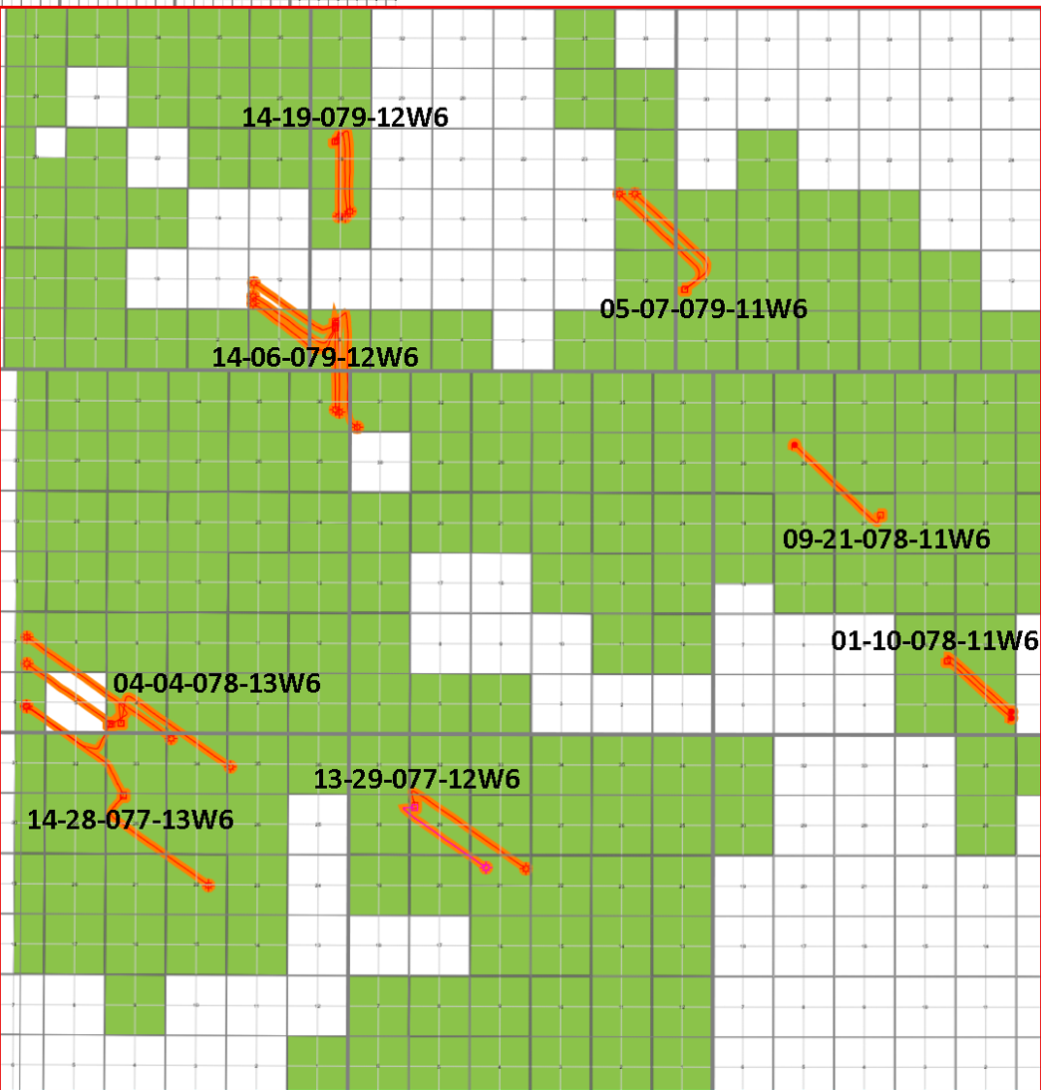
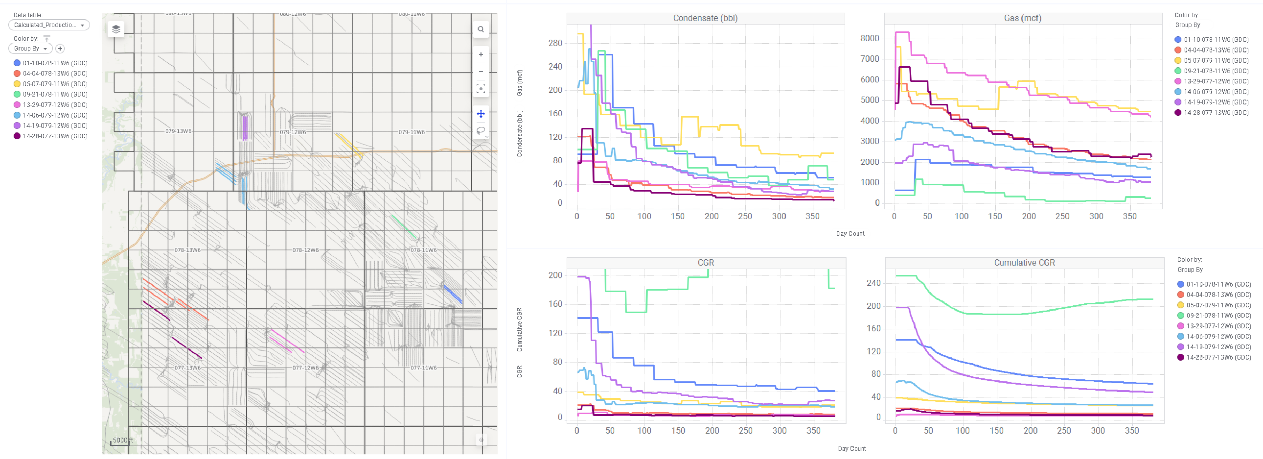
Pad Level Overview

Slide 7
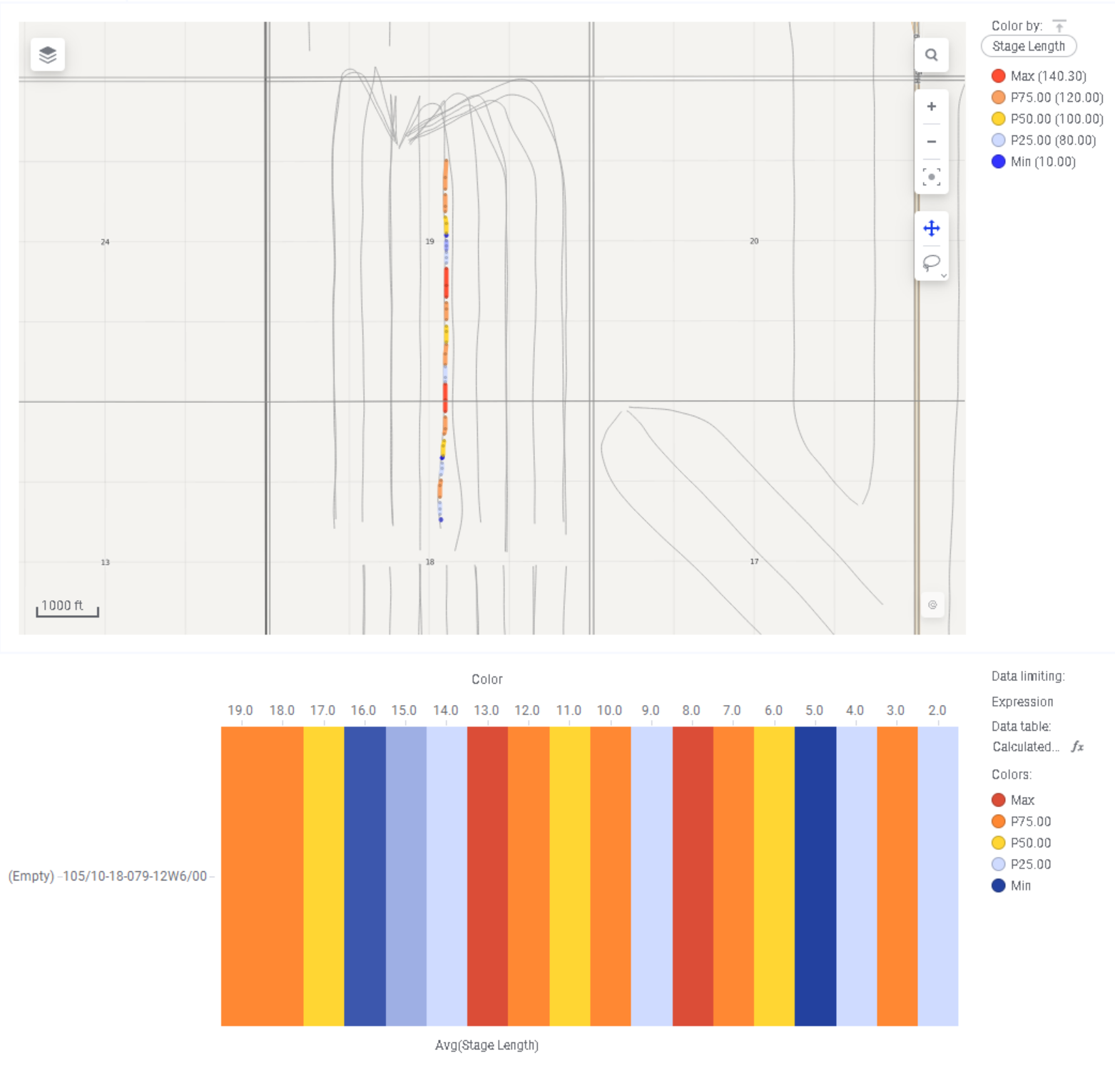
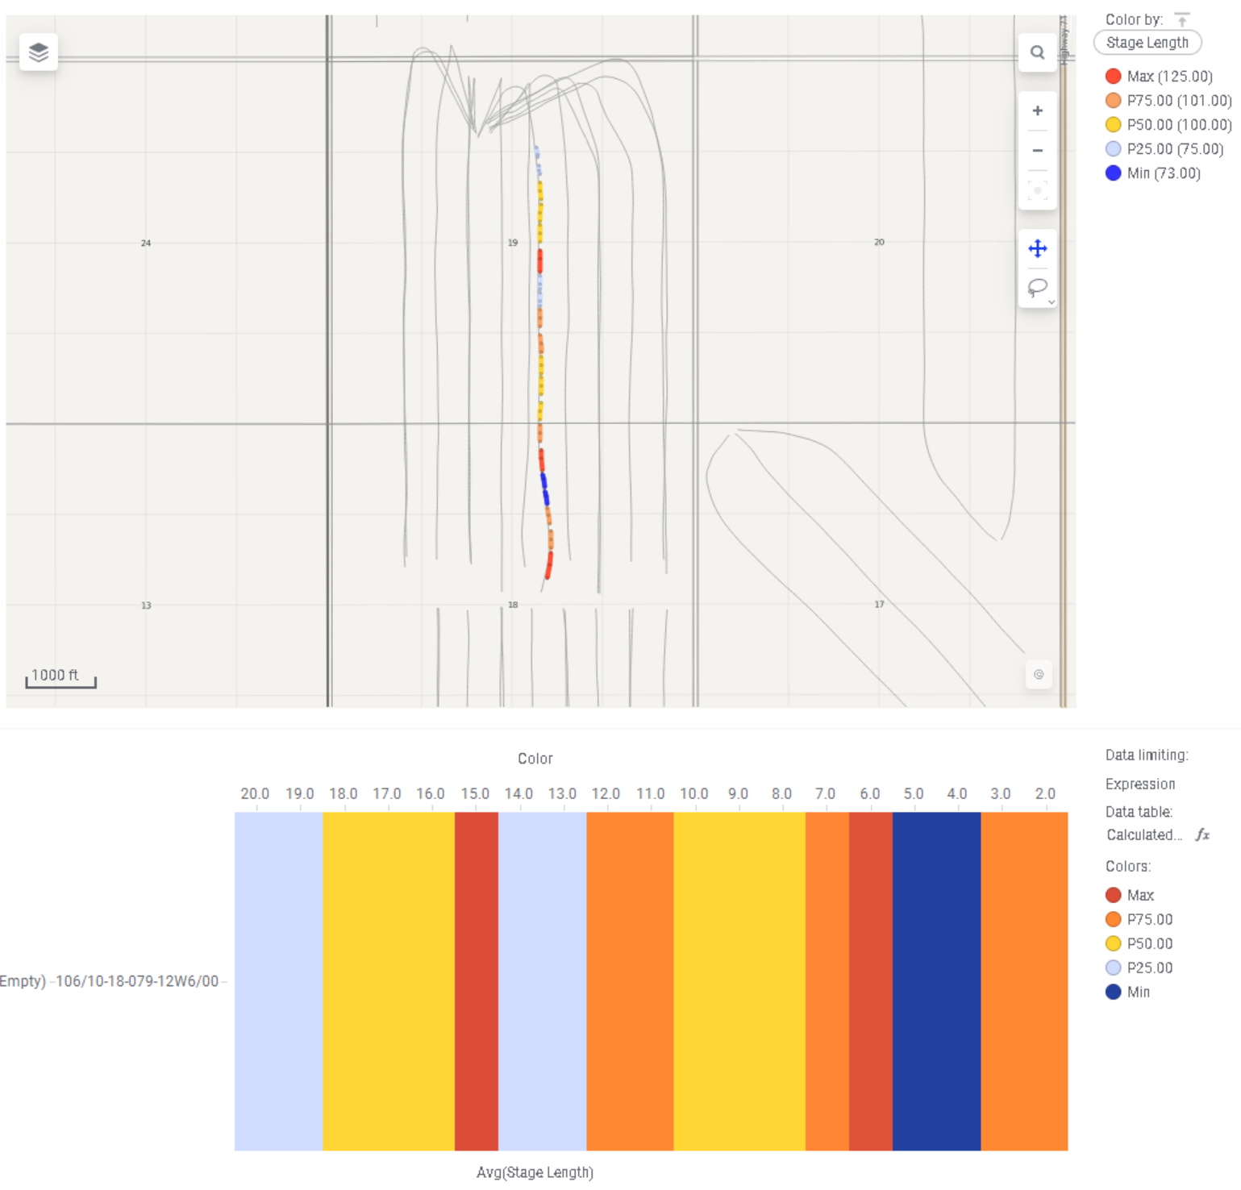
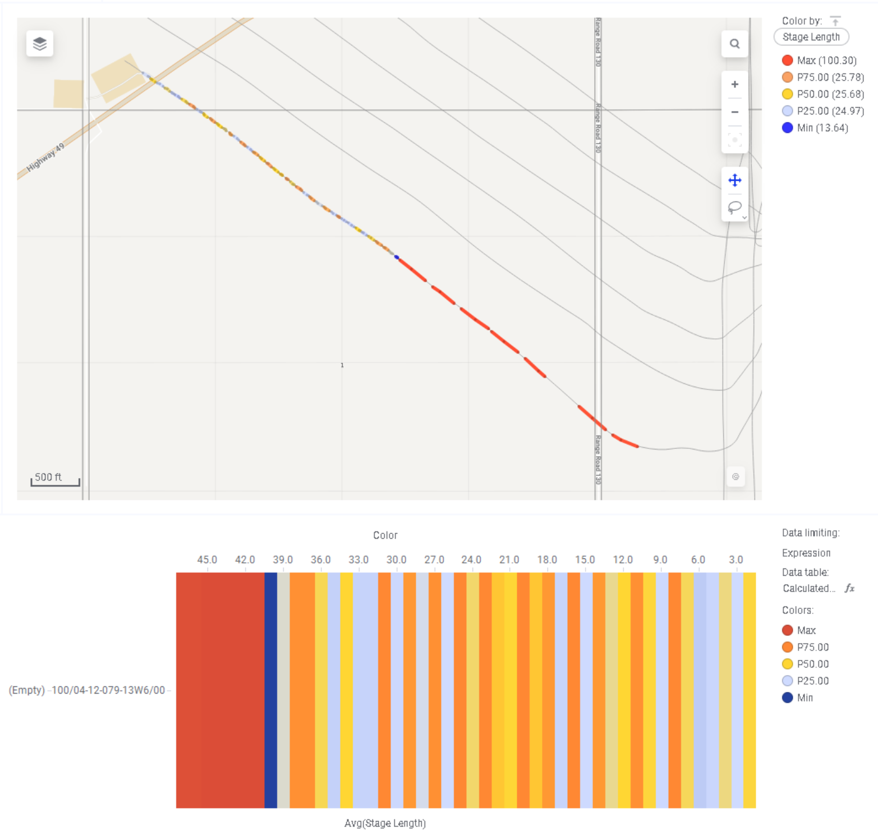
Manipulated Frac Designs
Individual Well Data
105/10-18-079-12W6/0 - Stage Spacing
106/10-18-079-12W6/0 - Stage Spacing
100/04-12-079-13W6/0 - Stage Spacing

Slide 8
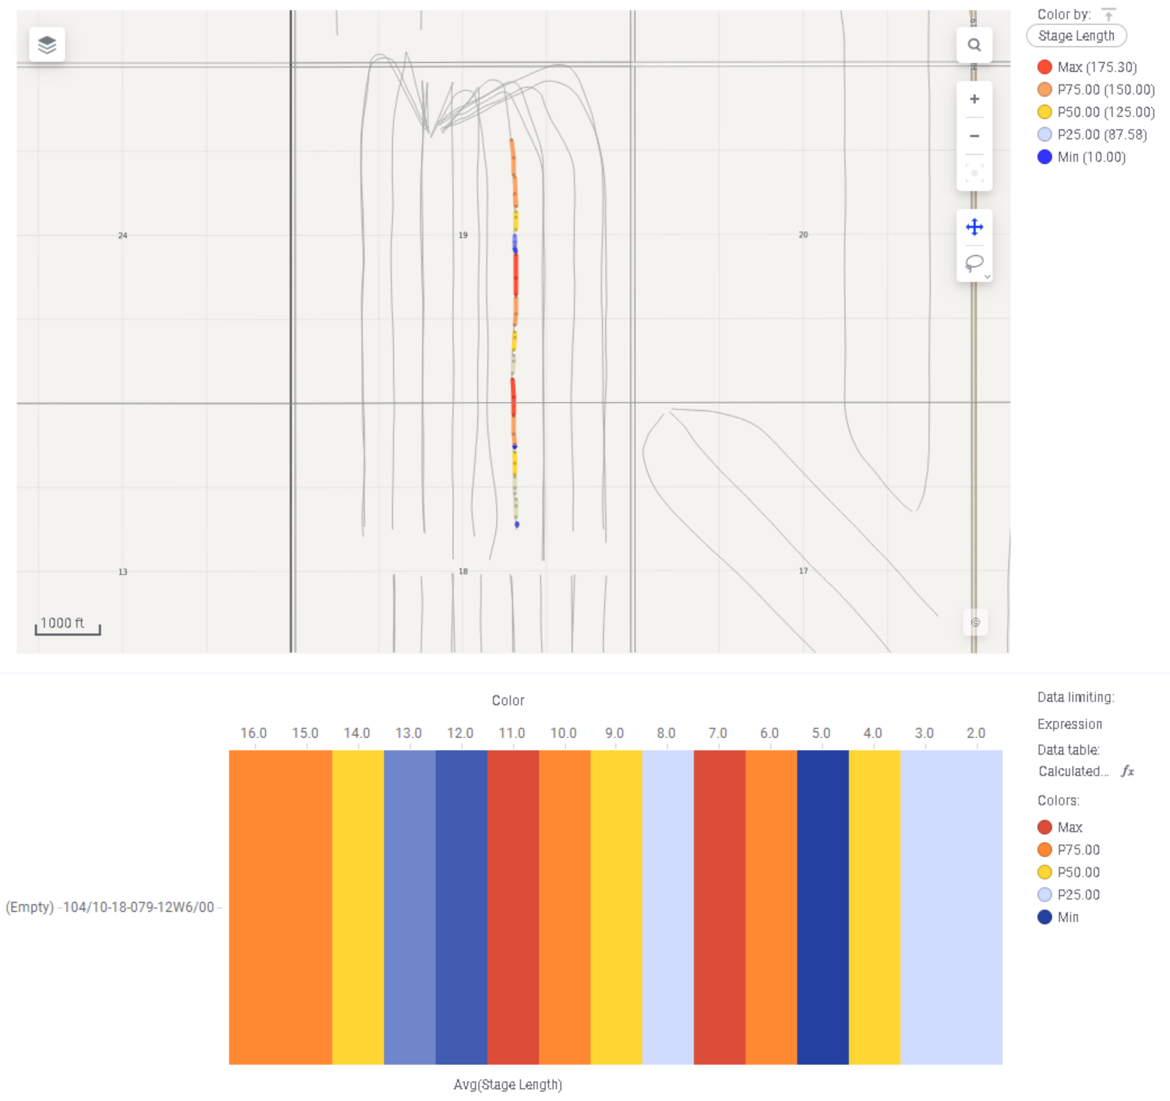
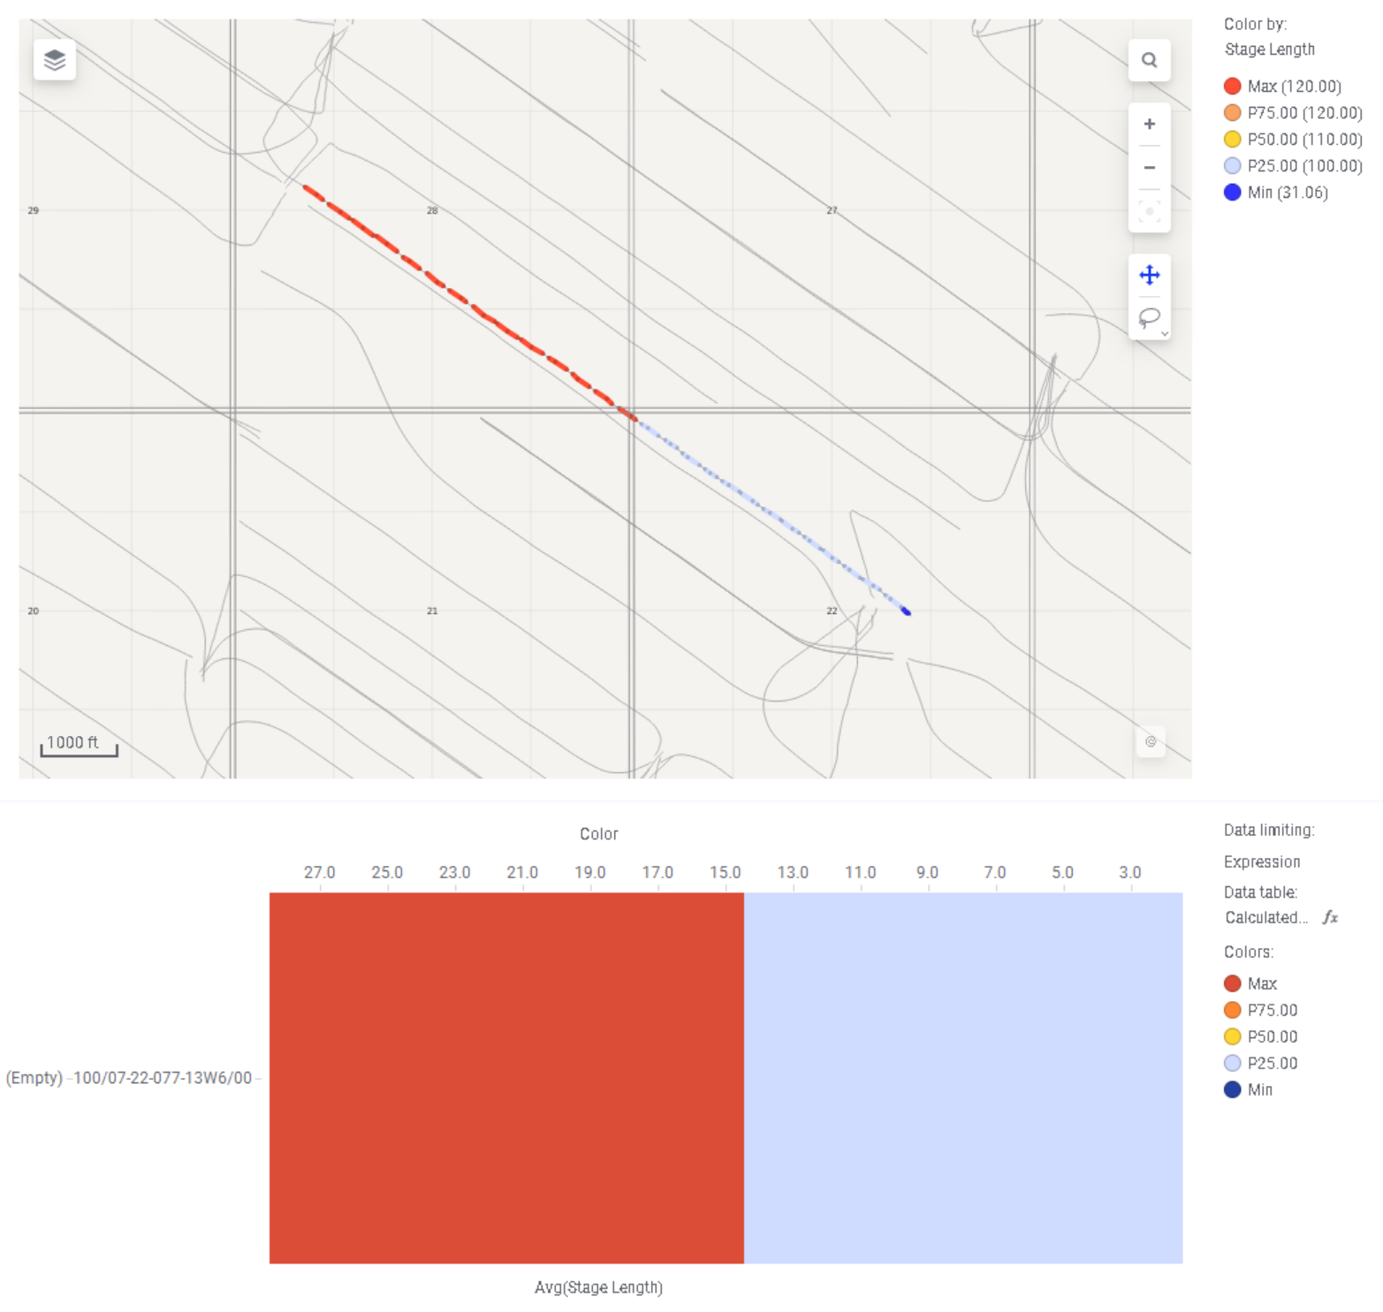
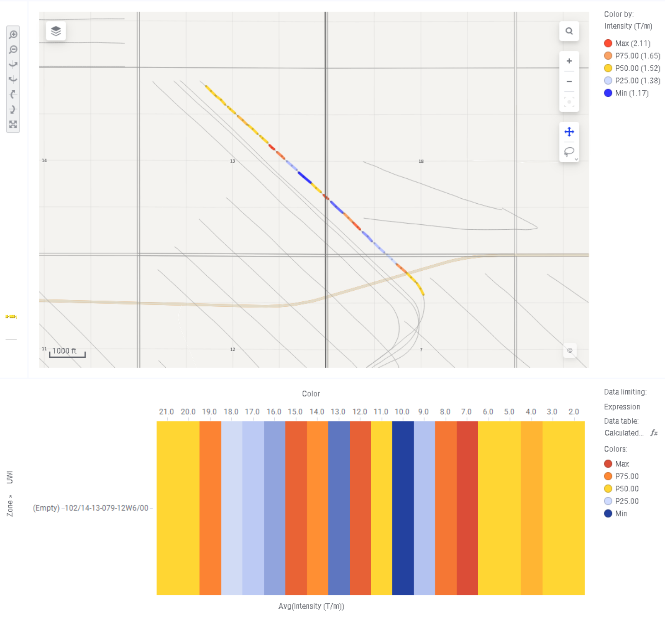
Manipulated Frac Designs
Individual Well Data
104/10-18-079-12W6/0 - Stage Spacing
100/07-22-077-13W6/0 - Stage Spacing
102/14-13-079-12W6/0 - Intensity

Slide 9
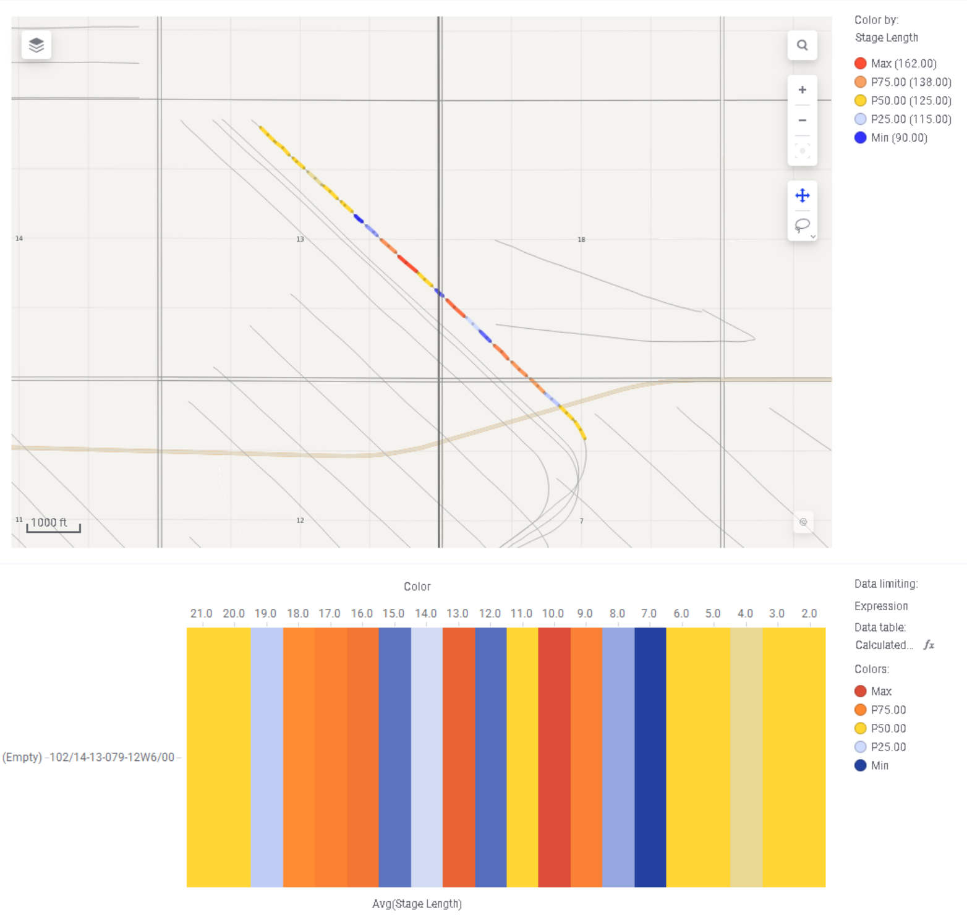
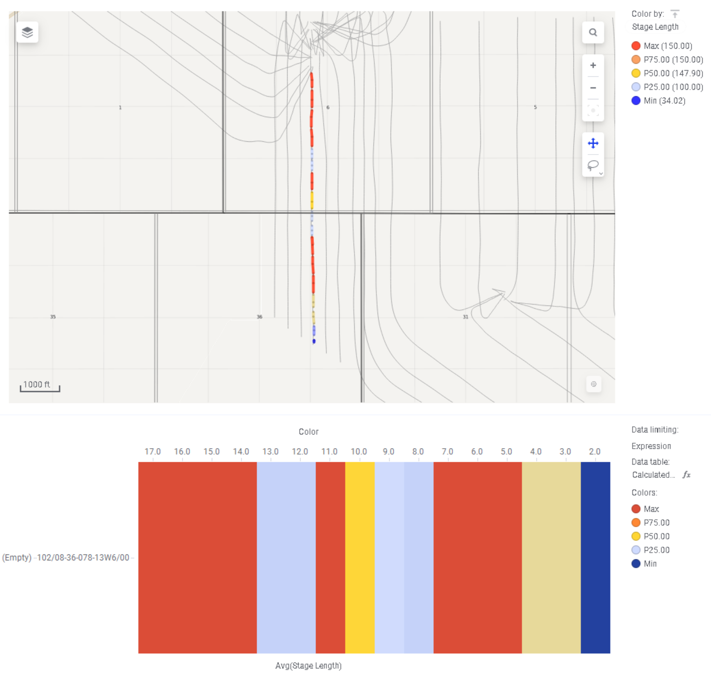
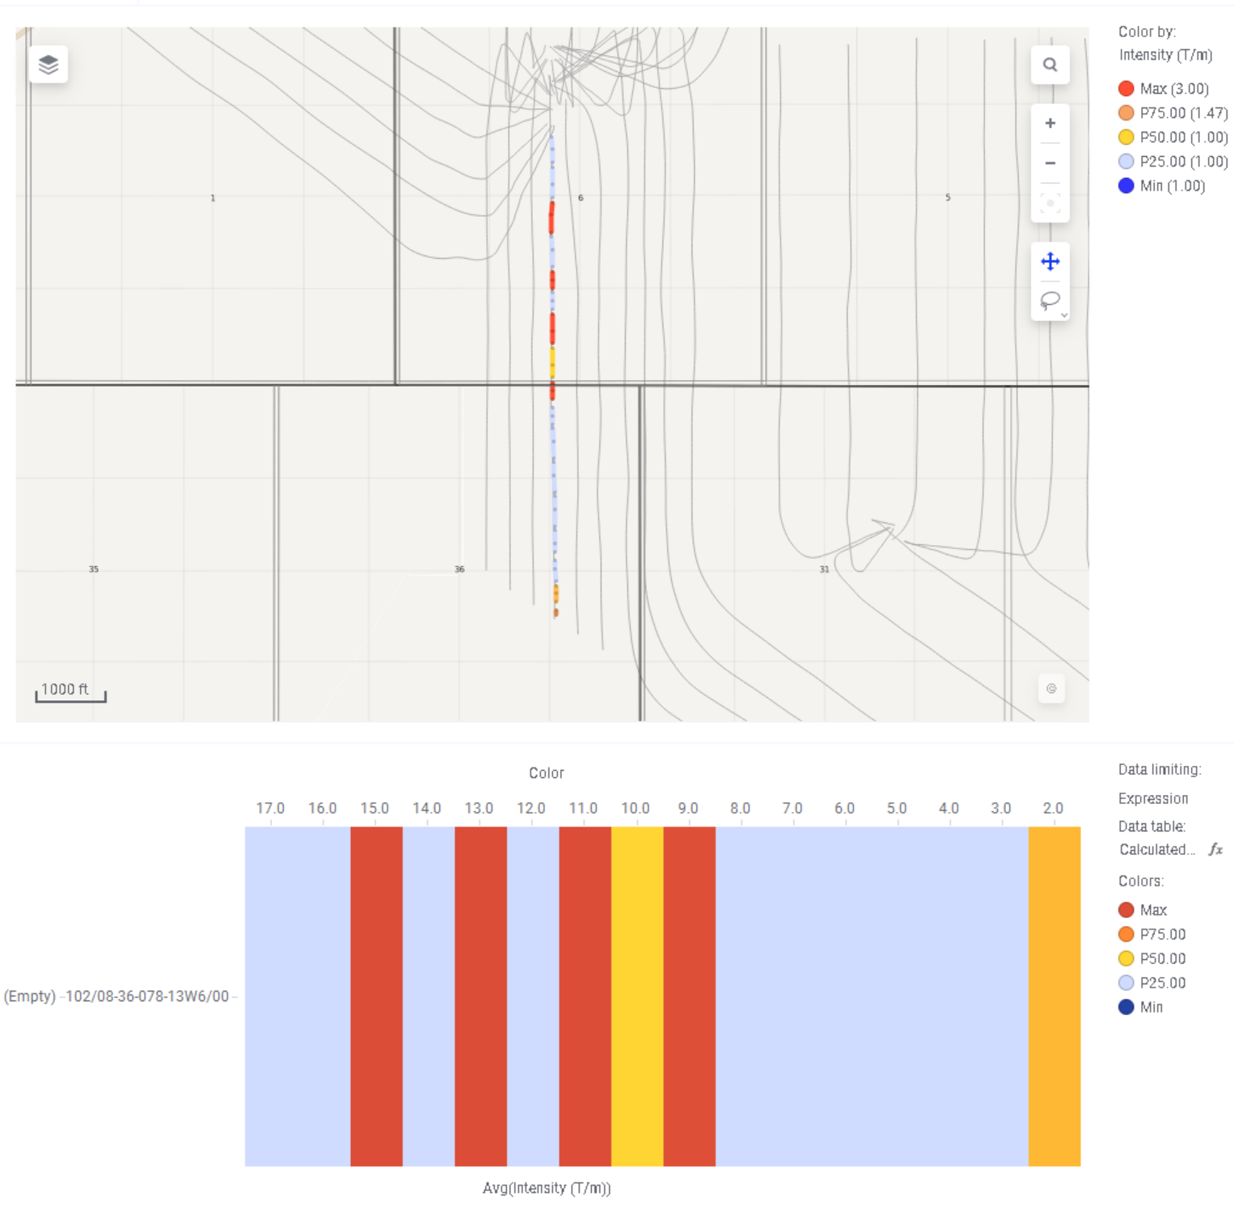
Manipulated Frac Designs
Individual Well Data
102/14-13-079-12W6/0 - Stage Spacing
102/08-36-078-13W6/0 - Stage Spacing
102/08-36-078-13W6/0 - Intensity

Slide 10
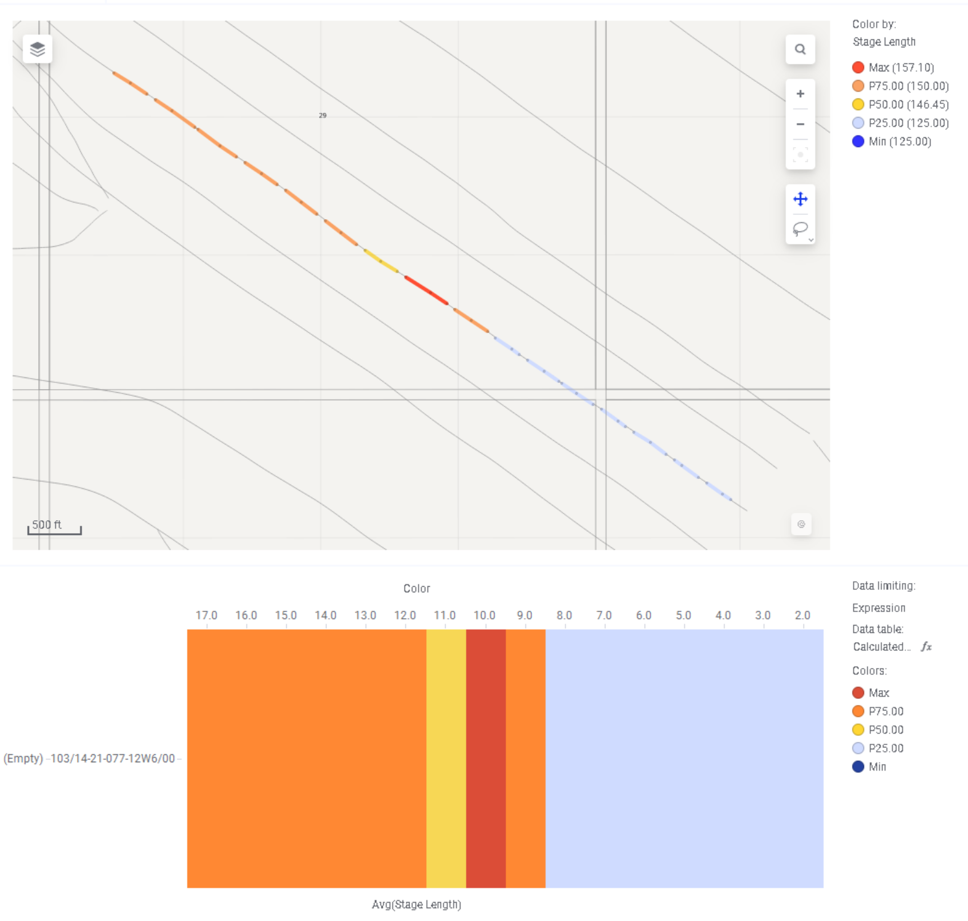
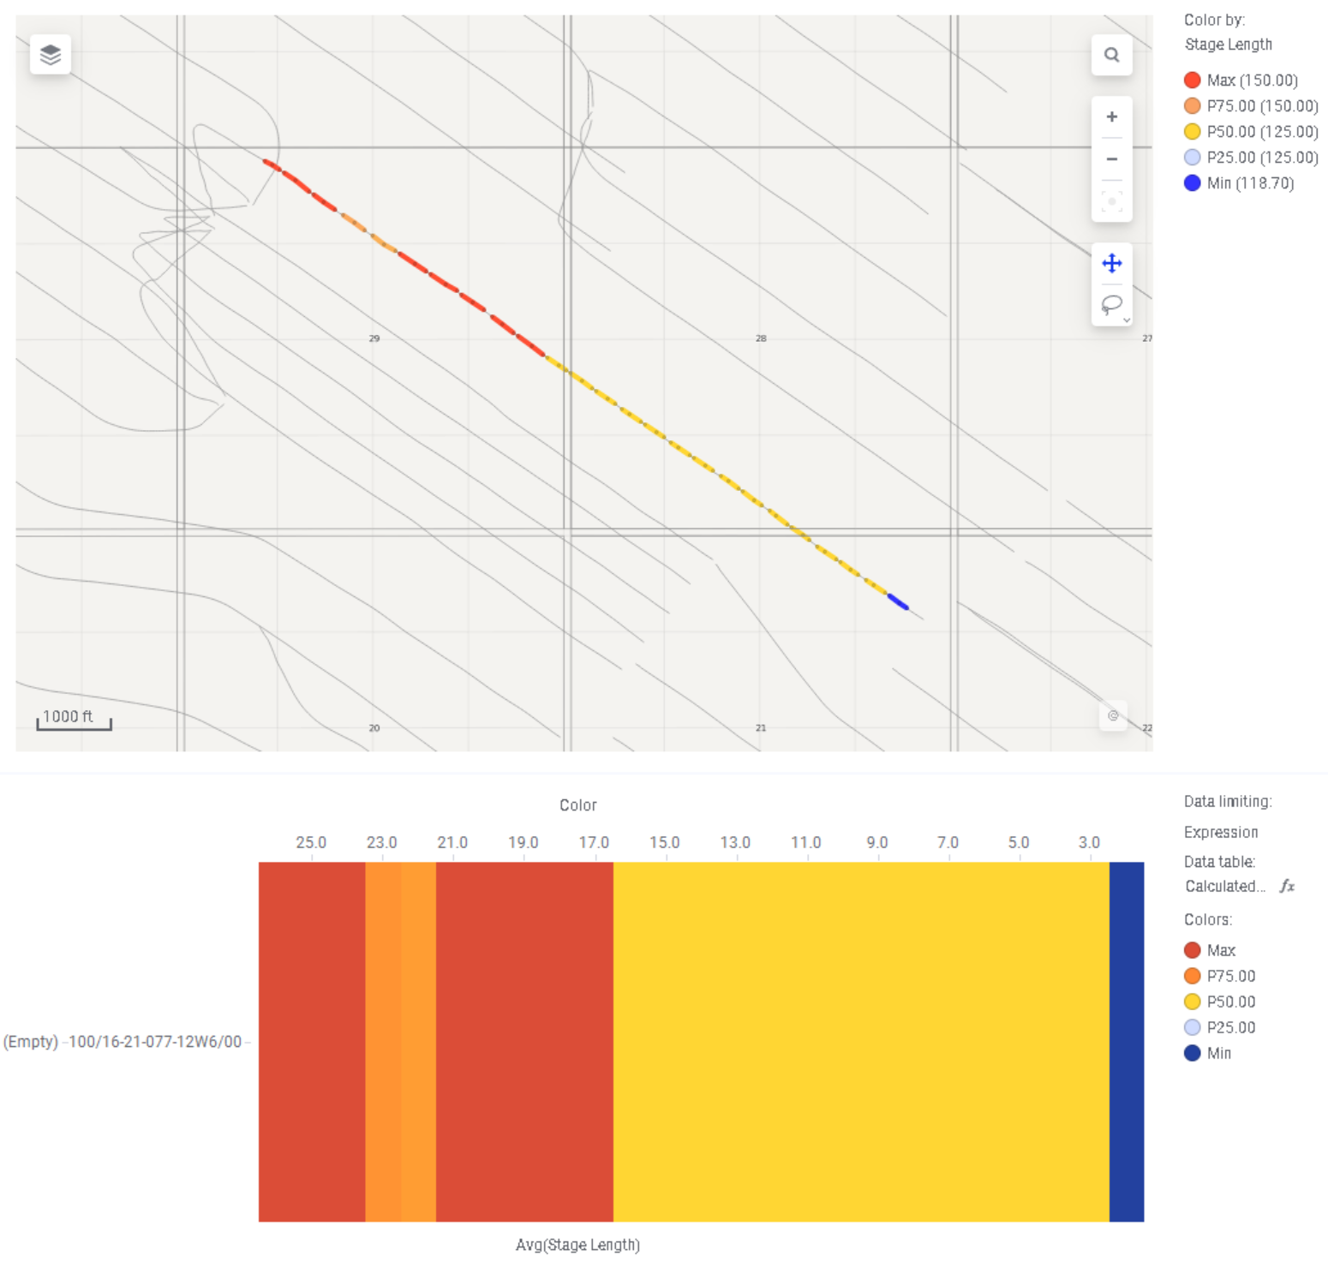
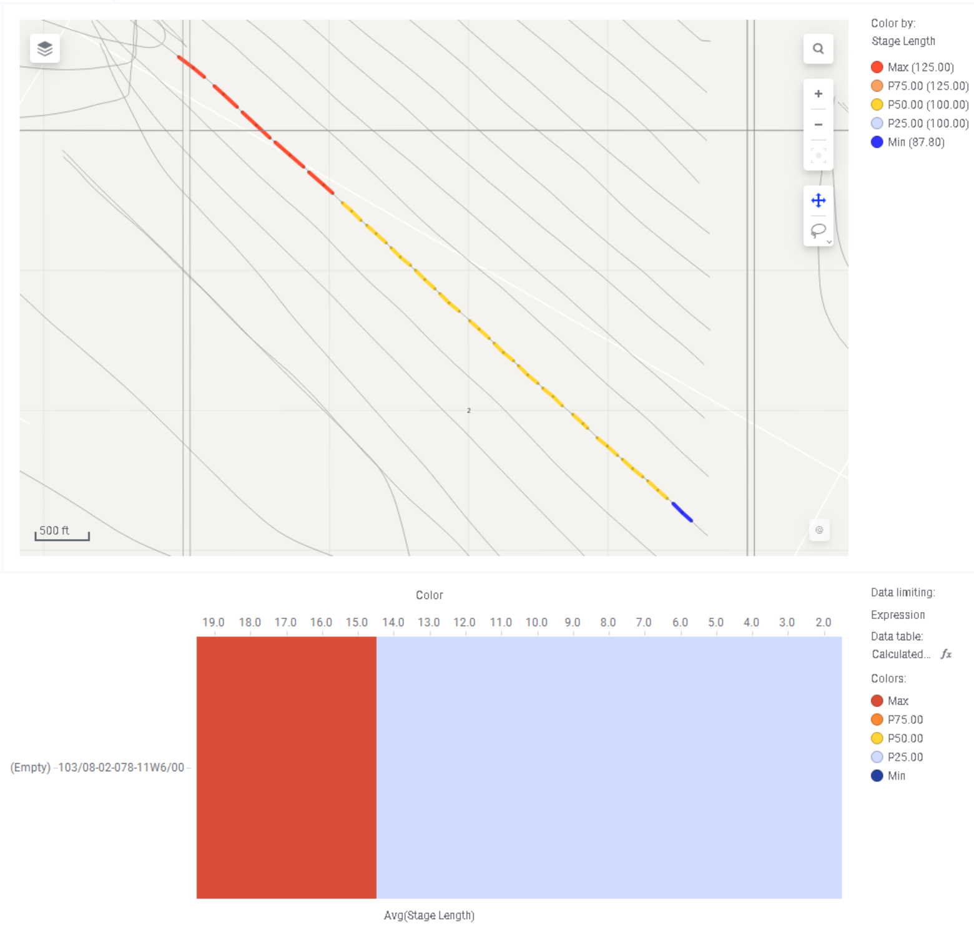
Manipulated Frac Designs
Individual Well Data
103/14-21-077-12W6/0 - Stage Spacing
100/16-21-077-12W6/0 - Stage Spacing
103/08-02-078-11W6/0 - Stage Spacing

Slide 11
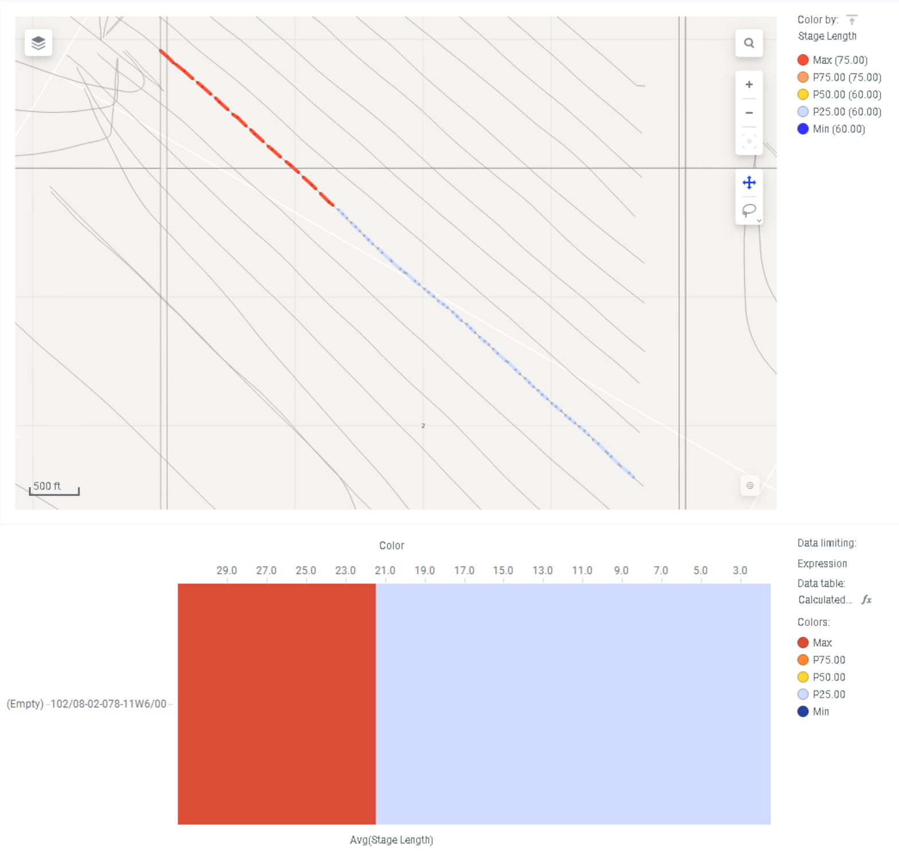
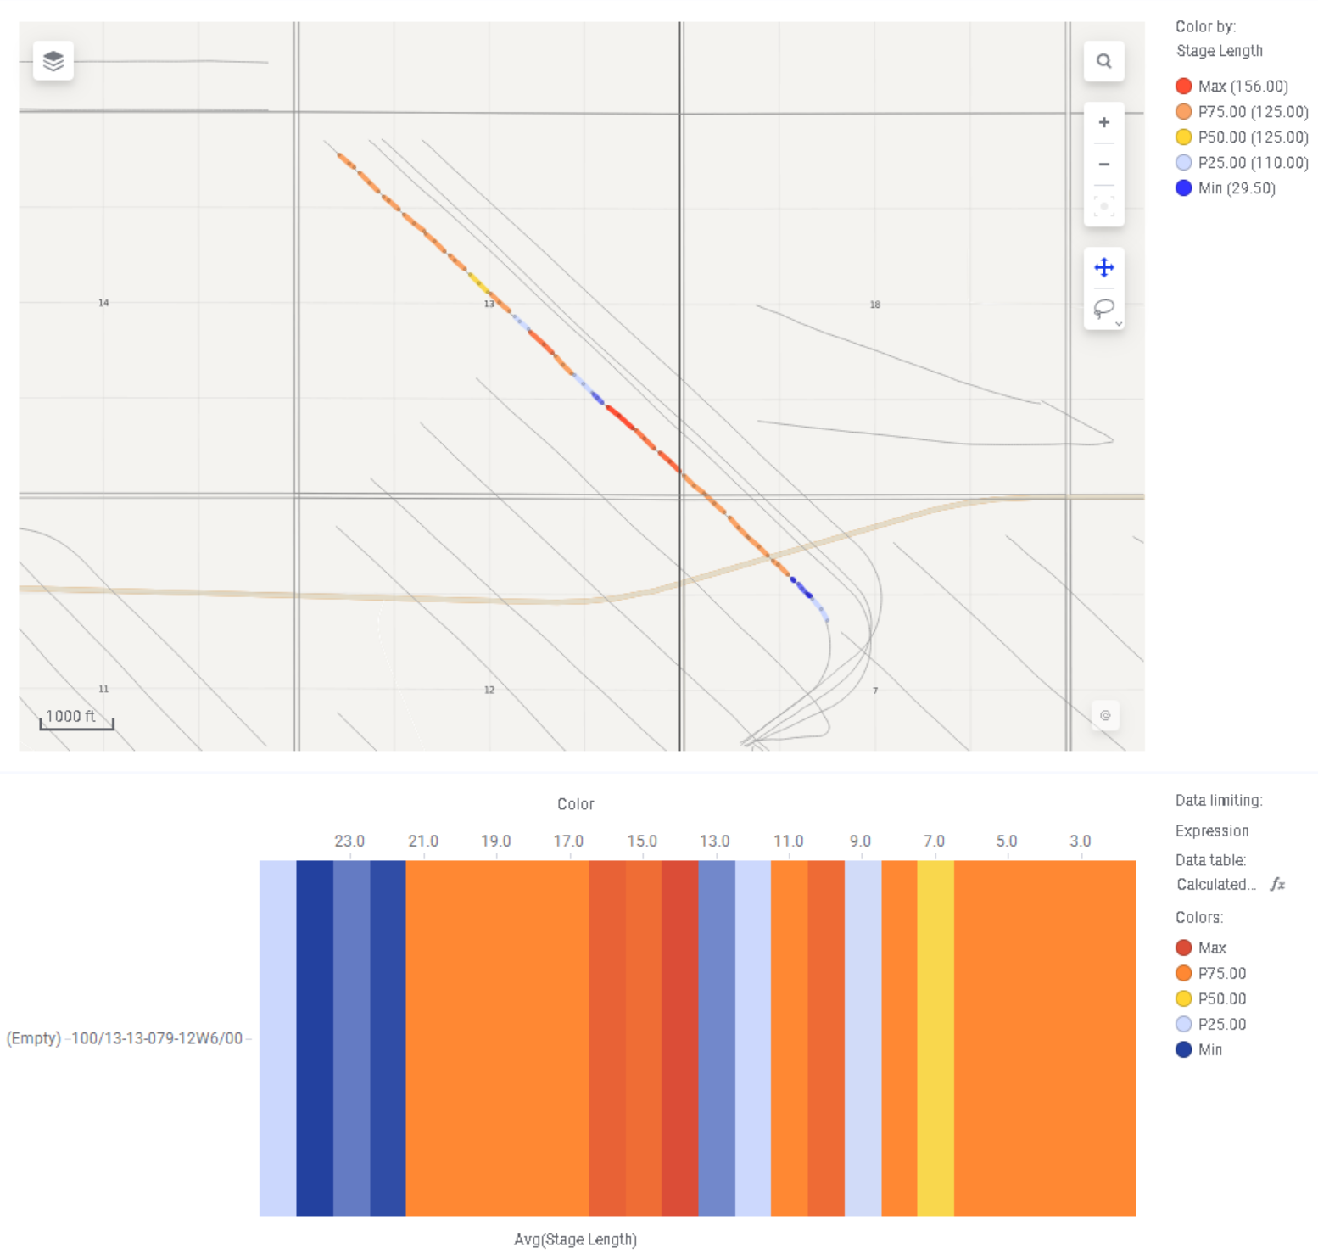
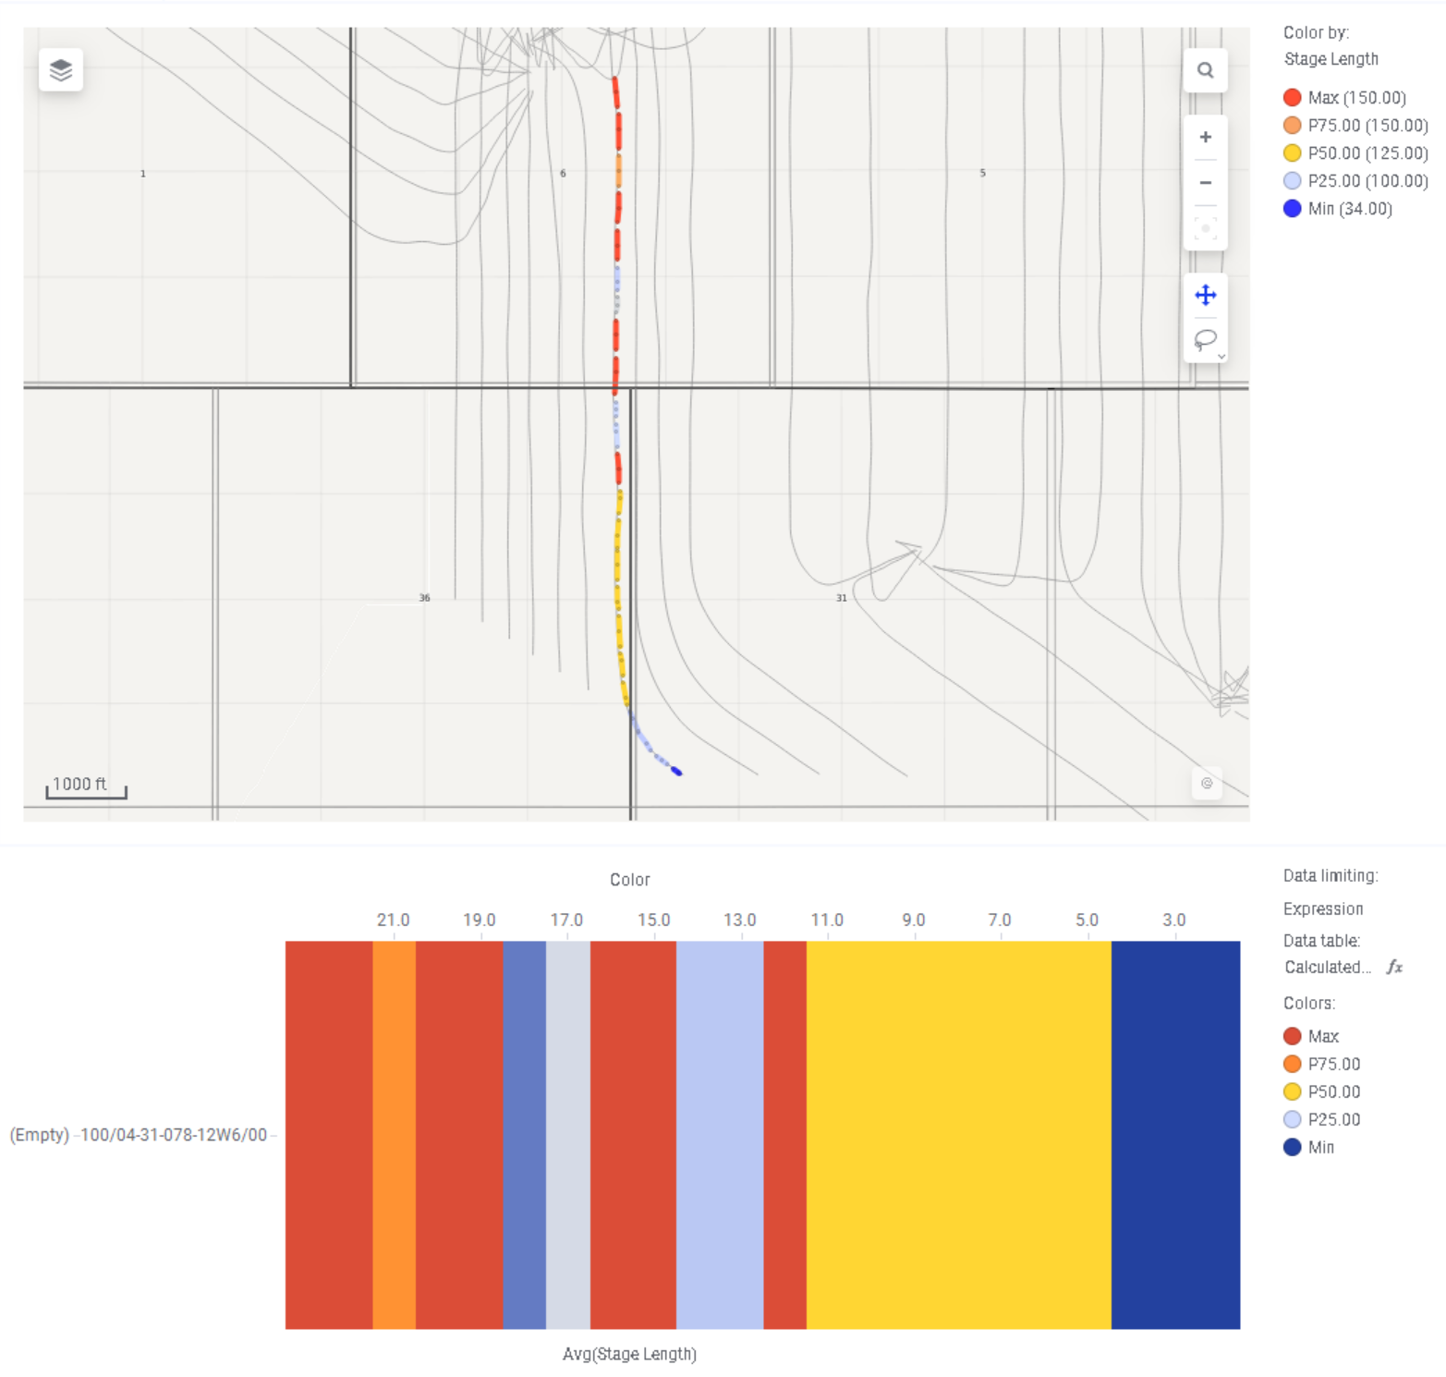
Manipulated Frac Designs
Individual Well Data
102/08-02-078-11W6/0 - Stage Spacing
100/13-13-079-12W6/0 - Stage Spacing
100/04-31-078-12W6/0 - Stage Spacing

Slide 12
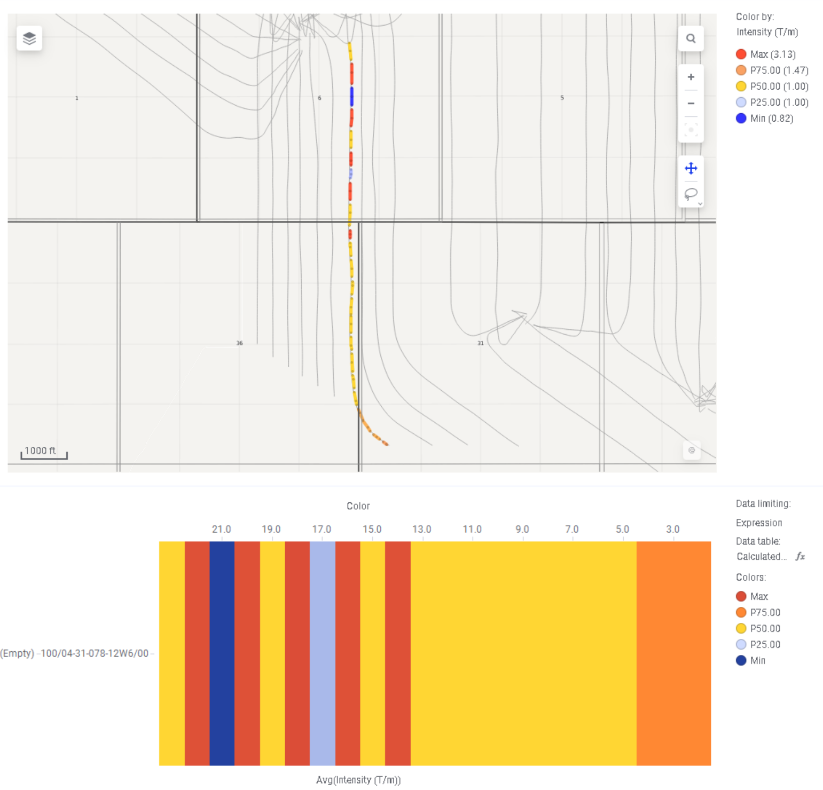
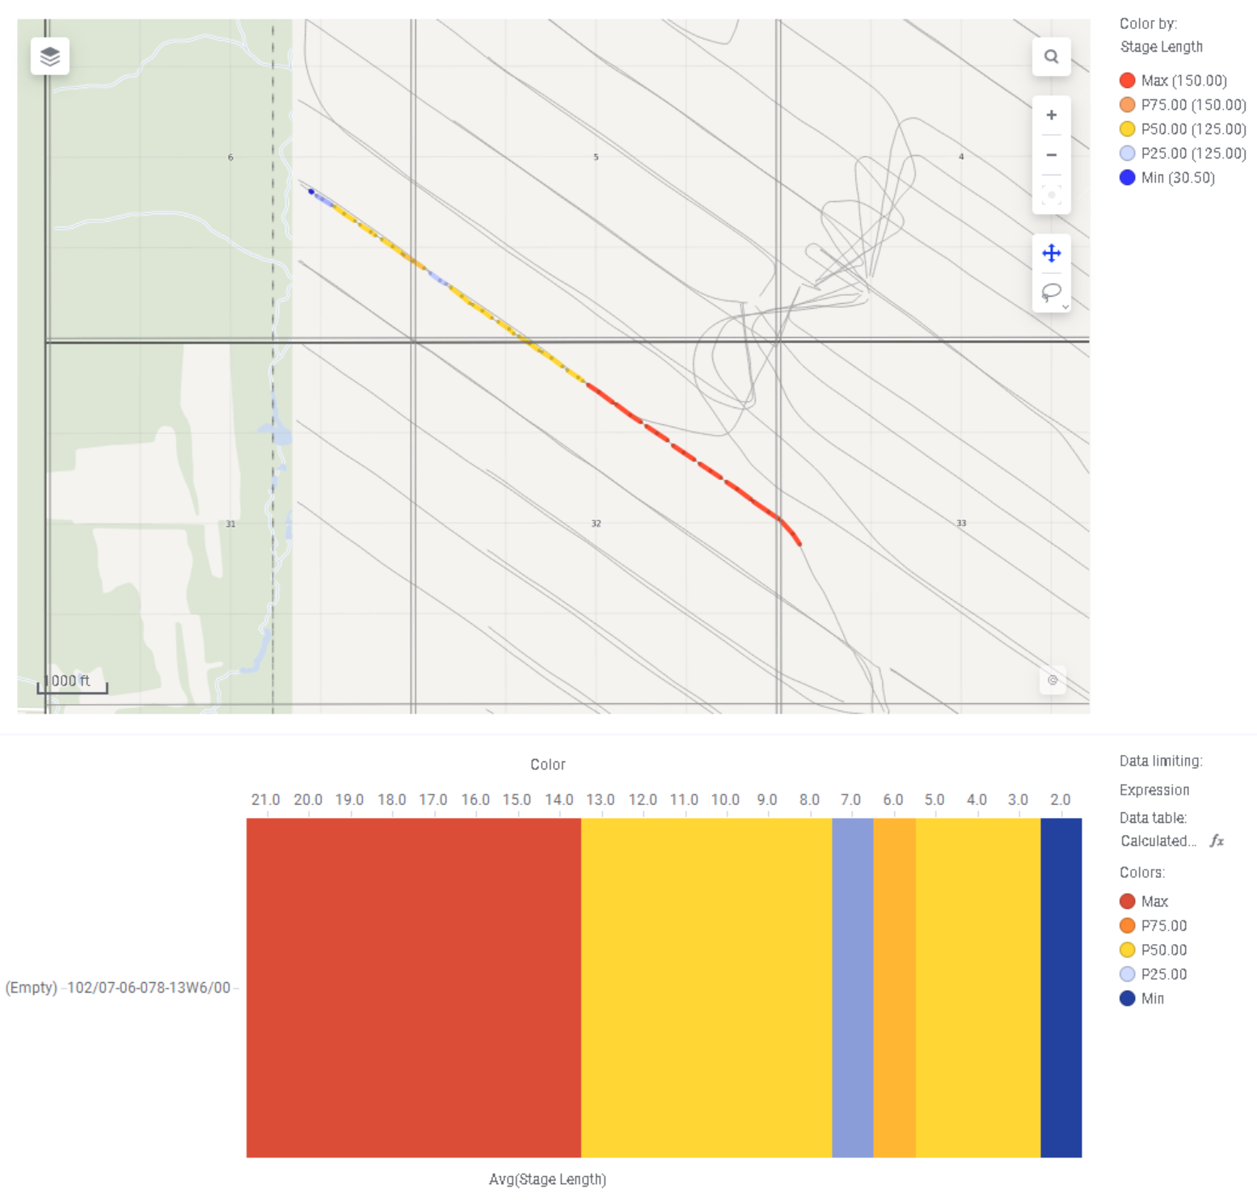
Manipulated Frac Designs
Individual Well Data
100/04-31-078-12W6/0 - Intensity
102/07-06-078-13W6/0 - Stage Spacing

